Slide 1
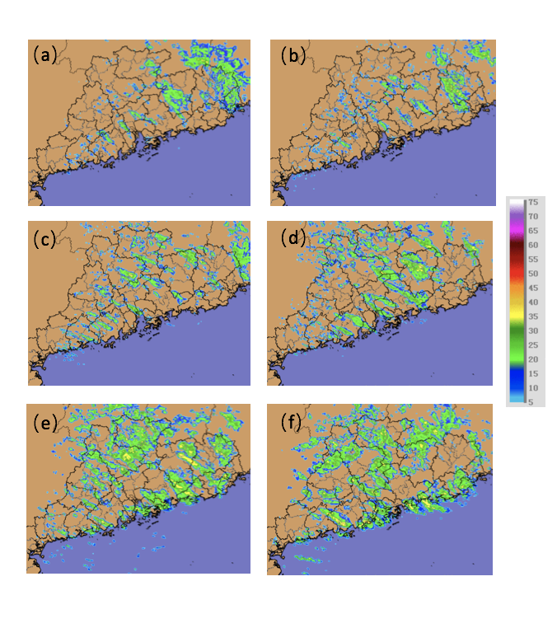
Banded Convective Activity associated with Gravity Waves over Southern China
Yu Du (杜宇)
Sun Yat-sen University, China
Collaborator:
Fuqing Zhang (PSU)
2018.08.16 in State College

Slide 2
Outline
Review of gravity waves
Case overview
Model simulations
Results
Convection and gravity waves
Wave-CISK
Wave ducting
Summary

Slide 3
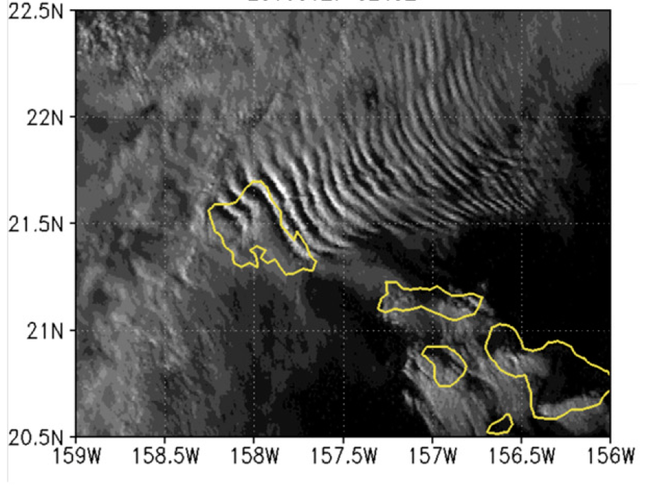
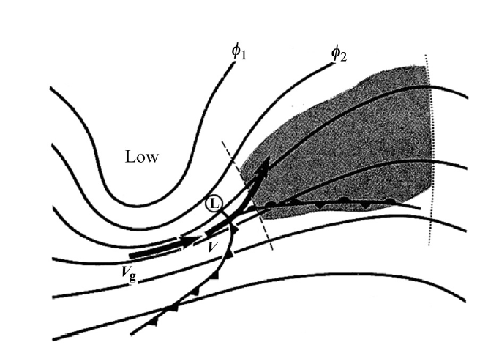
1. Review of gravity waves
Gravity waves are ubiquitous phenomenon observed in the atmosphere
mountains
(e.g. Liu et al. 2017; Li and Chen 2017)
Energy source
Front/jets
(e.g. Plougoven and Zhang 2015; Wang et al. 2018).
convection
(e.g.Lane 2015).
convection
mountains
Front/jets
Li and Chen 2017
Uccelini and Koch 1987
Lane and Zhang 2011

Slide 4
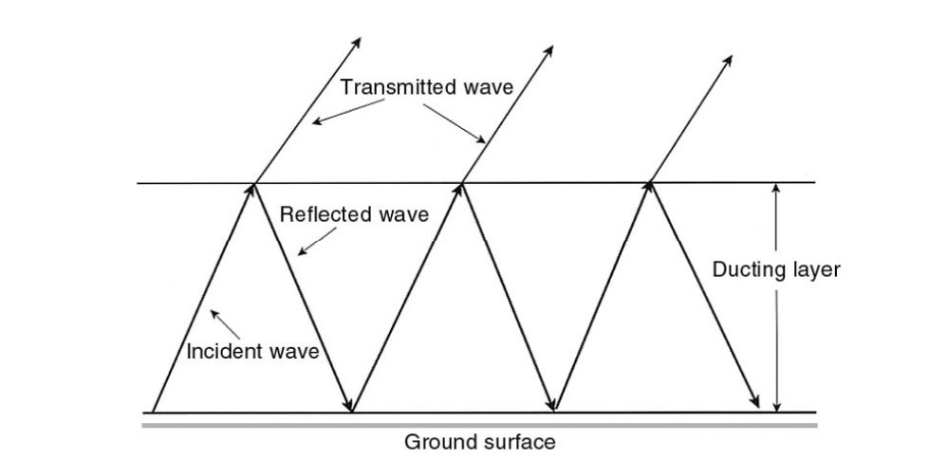
1. Review of diurnal cycle
Mechanisms of wavelike banded convection associated with gravity waves
coupling
Wave CISK
Convection
Gravity waves
(Zhang et al. 2001; Koch et al. 1988; Ruppert and Bosart 2014)
Wave duct
(Lindzen and Tung 1976; Ralph et al. 1993; Liu et al. 2018)

Slide 5
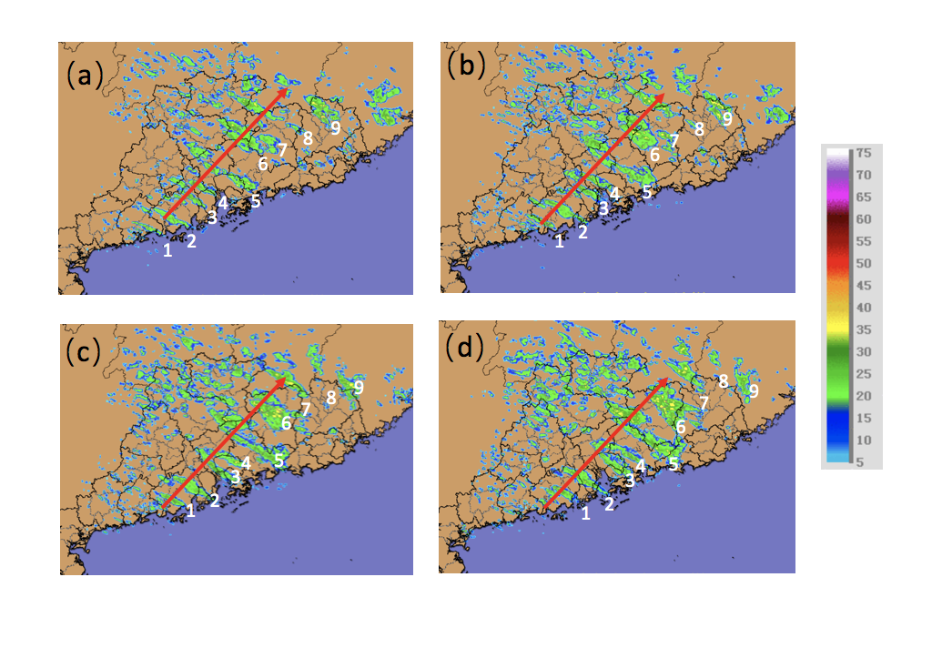
2.Case Overview
Wavelike banded convective activity occurred near the south coast of China on 30 Jan 2018
1300 UTC
1330 UTC
last: ~10 h
Spacing: ~30-40 km
1400 UTC
1430 UTC
Propagate northeastward in a speed of ~12 m/s
Radar reflectivity

Slide 6
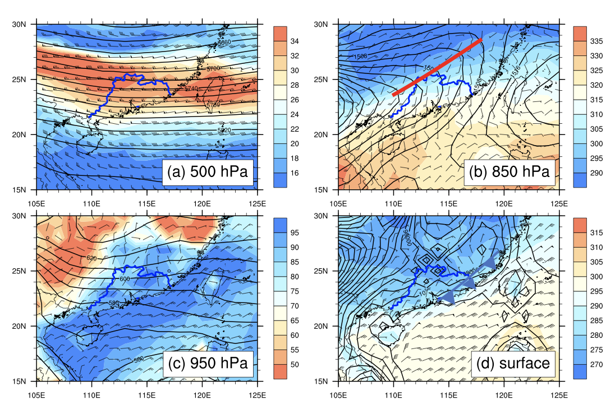
2.Case Overview
Background circulation at 1200 UTC 30 Jan 2018
Strong westerly wind at 500 hPa
Shear line at 850 hPa
High moisture at 950 hPa
Cold front at surface

Slide 7
2.Case Overview
Three scientific questions needs to be addressed
What’s the role of banded convection in the development of gravity waves?
Why did the wavelike pattern of convection last for a long time?
What factors determine the phase speed and wavelength of the gravity waves?

Slide 8
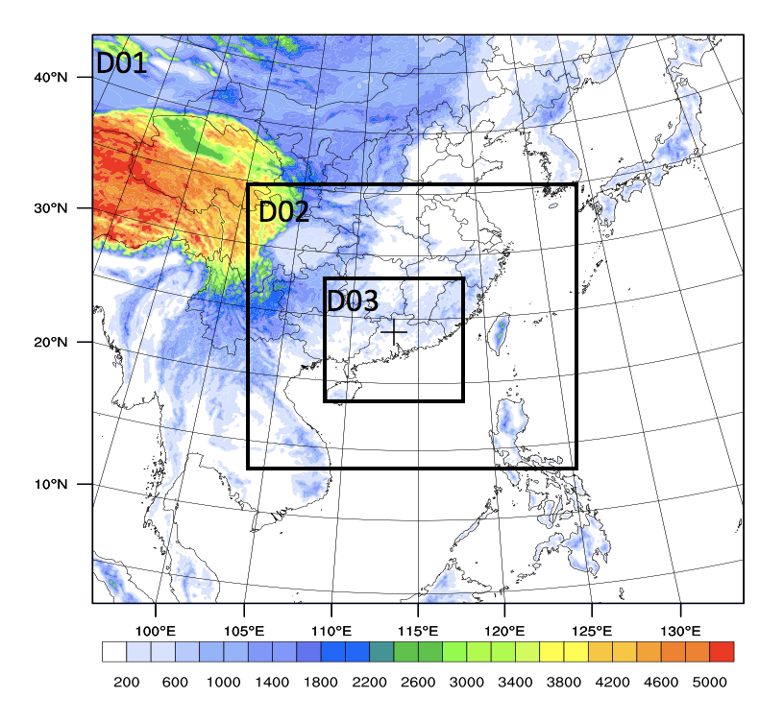
3.Model simulation
WRF-ARW
9km-3km-1km
51 level
Thompson microphysics
rrtmg radiation scheme
Revised MM5 Monin-Obukhov surface-layer scheme
Unified Noah land-surface model
KF cumulus (d01)
Experiment | Start time (UTC) | Latent heating | Terrain | Purposes of experiment
Control run | 1200 UTC | Yes | real | Full physics control run
INL-A run | 0000 UTC | Yes | real | Sensitivity to initial time
INL-B run | 0600 UTC | Yes | real | Sensitivity to initial time
FakeDry-A run | 1200 UTC | No | real | Latent heating effect (Wave-CISK)
FakeDry-B run | 1200 UTC | No latent heating from 1800 UTC | real | Latent heating effect (Wave-CISK)
TER-A run | 1200 UTC | Yes | Increase surface 500 m over land | The depth of stable layer (Wave duct)
TER-B run | 1200 UTC | Yes | Increase surface 500 mover land and ocean | The depth of stable layer (Wave duct)
Sensitivity tests:

Slide 9
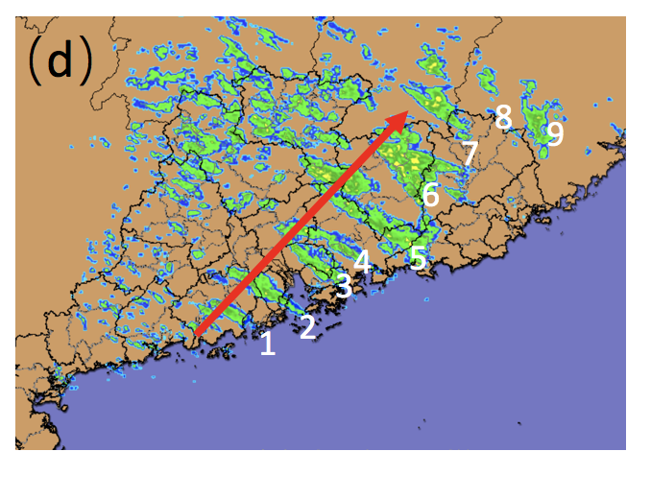
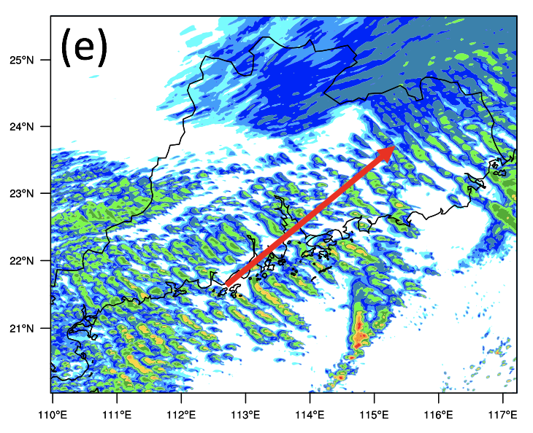
3.Model simulation
observation
simulation
wavelength: ~30-40 km
wavelength: ~20-40 km
Propagate northeastward in a speed of ~12 m/s
Propagate northeastward in a speed of ~12 m/s
Time: 0800~1800 UTC
Time: 1300~2300 UTC

Slide 10
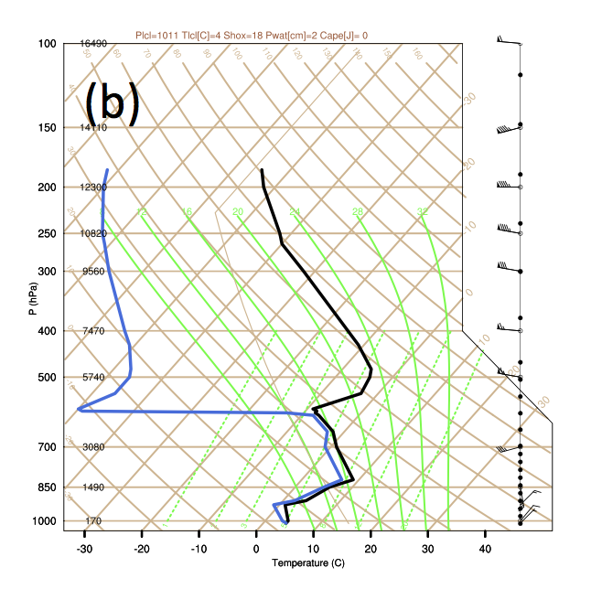
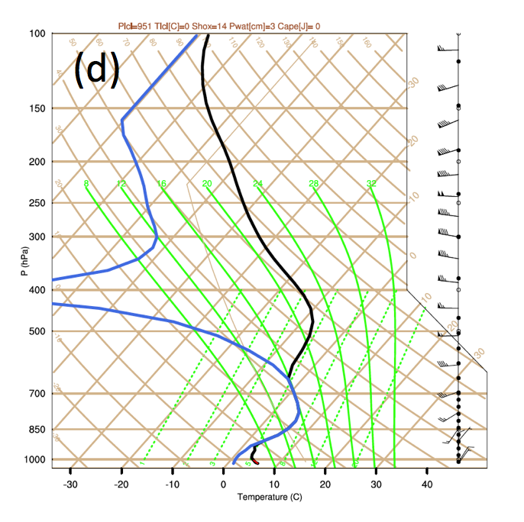
3.Model simulation
observation
simulation
600hPa
850hPa

Slide 11
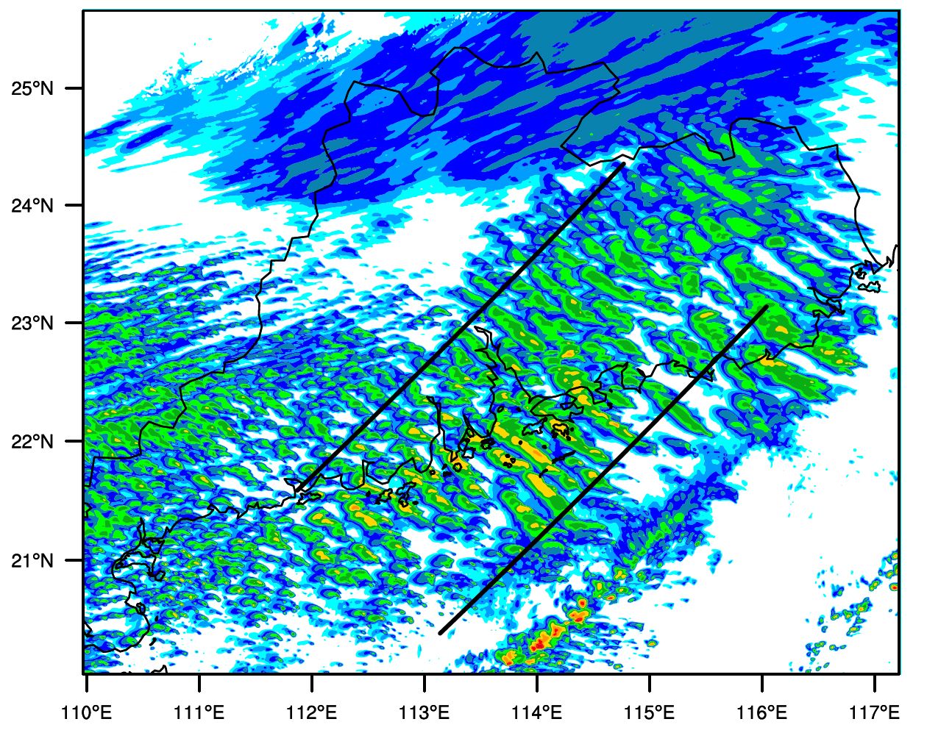
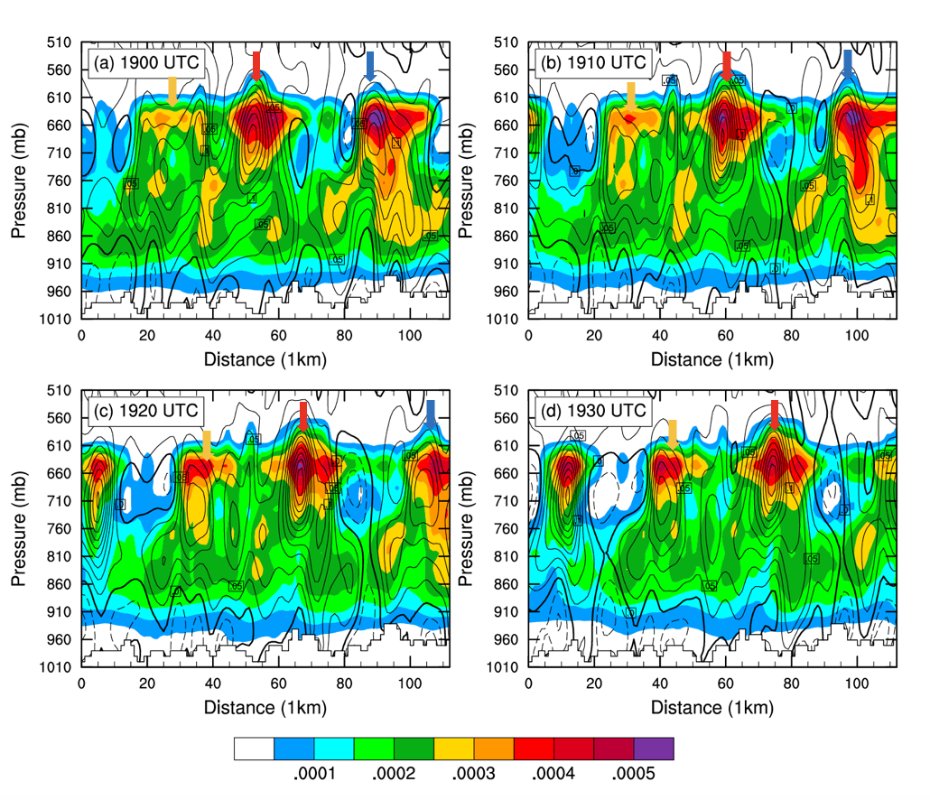
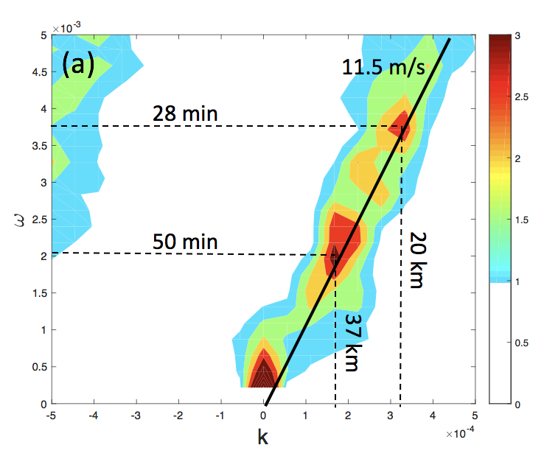
4. Results: convection and gravity waves
Vertical cross section of water vapor mixing ratio (shading) and vertical motion (contour)
~40km
Power spectrum

Slide 12
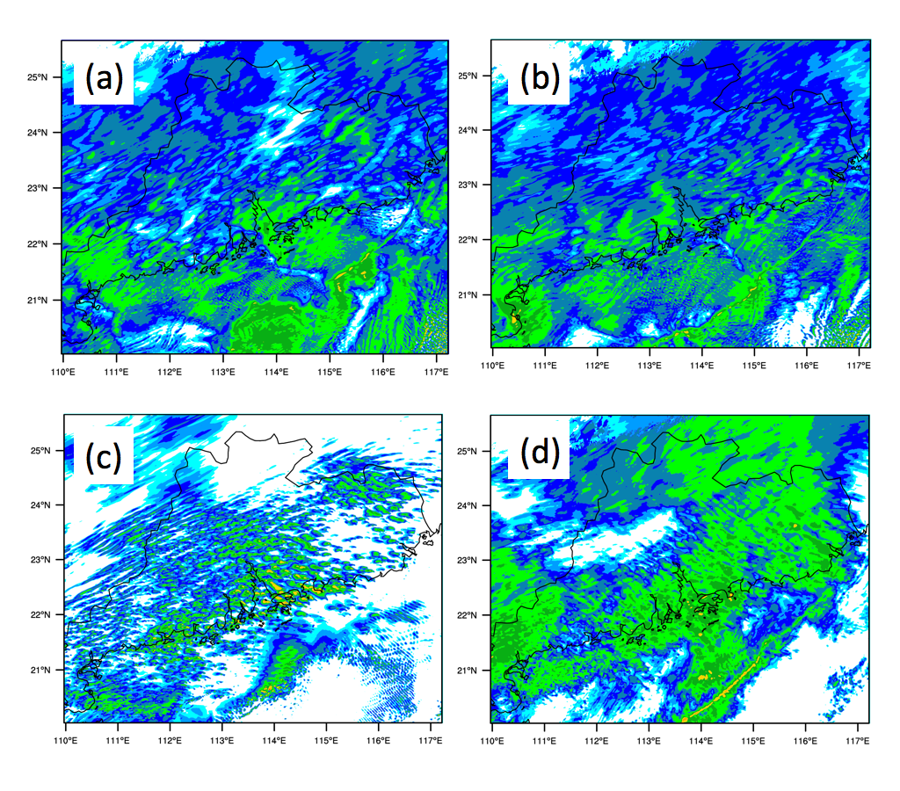
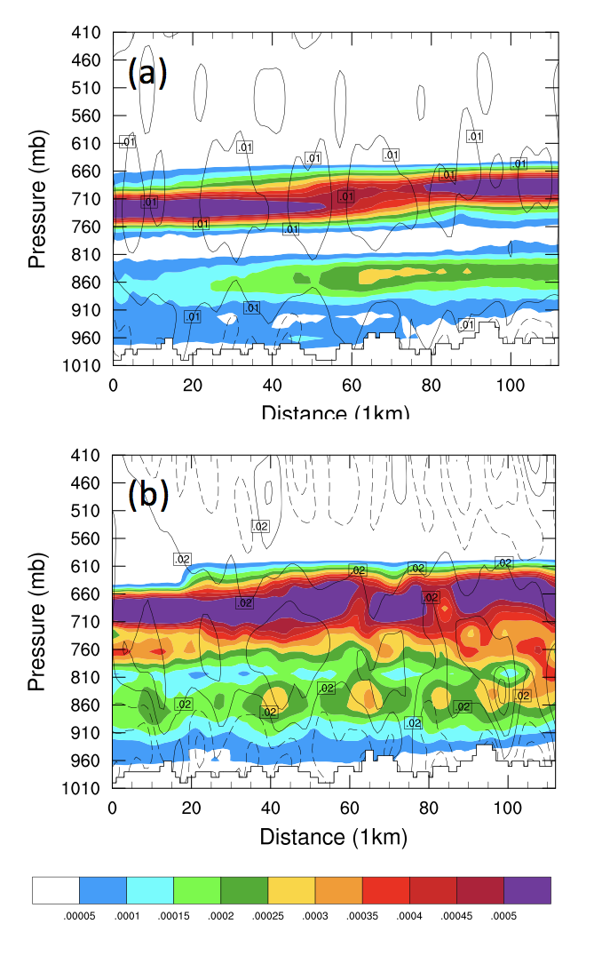
4. Results: Wave-CISK
Convection and gravity waves are coupled
Fakedry sensitivity tests: Turn off the latent heating
1700 UTC
1900 UTC
1900 UTC
Fakedry-A
Fakedry-B

Slide 13
4. Results: Wave duct
A classical wave duct --- keep energy in the duct
Stable layer
Less stable/unstable layer
Critical level
Reflection
Ri <1/4
stable layer
Duct layer
Lindzen and Tung (1976)

Slide 14
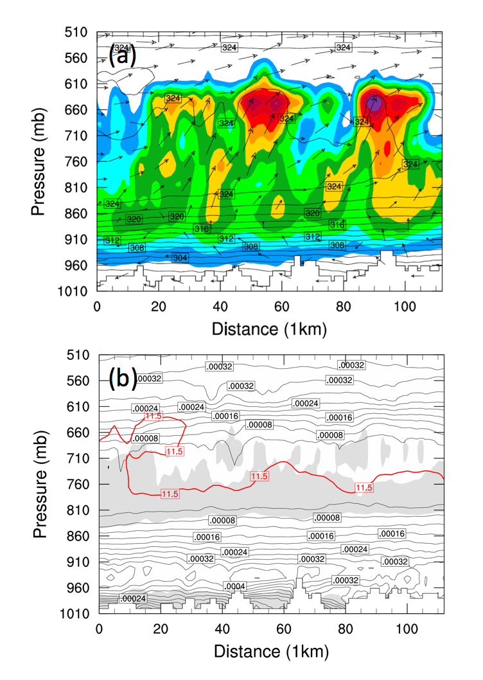
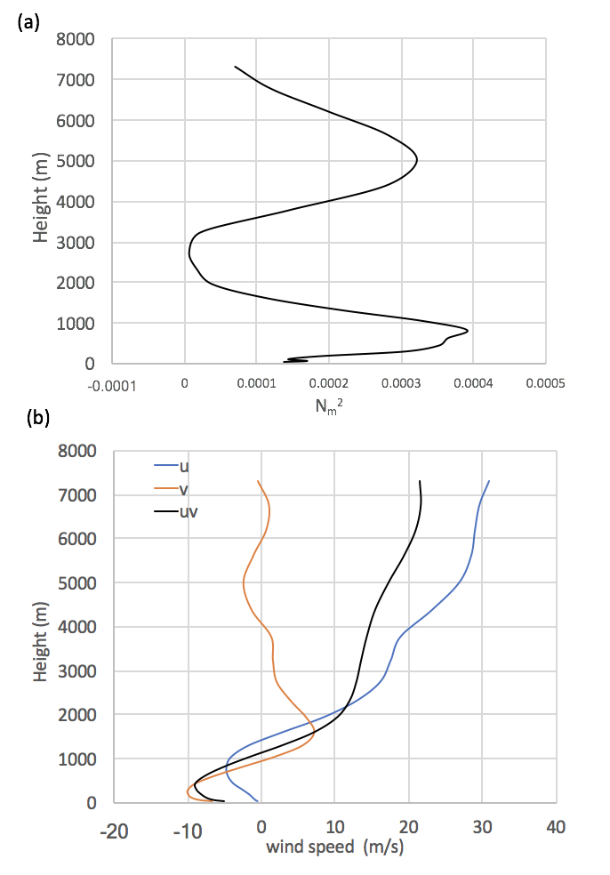
4. Results: Wave duct
Moist static stability
Cloud water mixing ratio (shading)
$θ_{e}$ (contour)
Winds
Richardson number <1/4 ( grey shading)
Moist static stability (contour)
Critical level (red line)
southwesterly
northeasterly

Slide 15
4. Results: Wave duct
Calculation on wave phase speed and wavelength
Moist static stability
The depth of the stable layer
Intrinsic phase speed
$$C_{d}=\frac{N_{m}D}{\left(\frac{π}{2}+n\right)}=\frac{0.016 s^{−1}×1500m}{\frac{3.14}{2}+0}=15.2 m s^{−1}$$
Ground-relative phase speed
$$C=C_{d}+U=15.2 m s^{−1}−3 m{ s}^{−1}=12.2 m{ s}^{−1}$$
Horizontal wavelength
36.6 km when T=50 min
20.6 km when T=28 min
$λ_{x}=T\left(\frac{N_{m}λ_{z}}{2π}+\overline{U}\right)$=$T\left(\frac{N_{m}×4×D}{2π}+\overline{U}\right)$
might be related to the lifecycle of convection

Slide 16
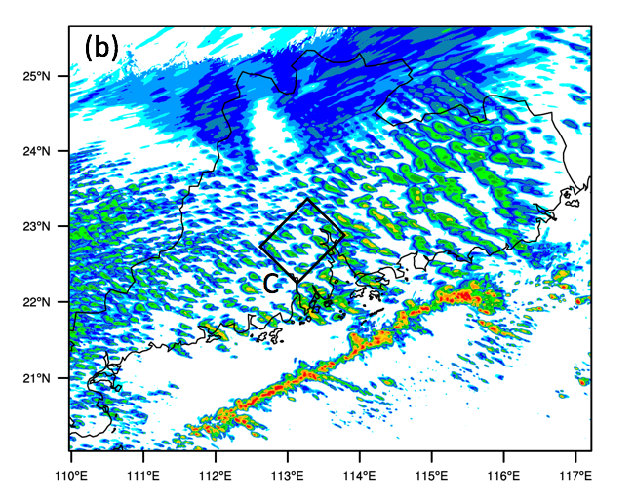
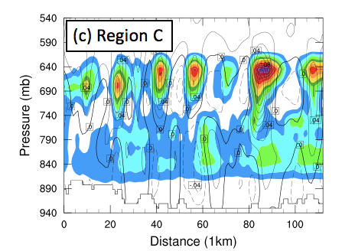
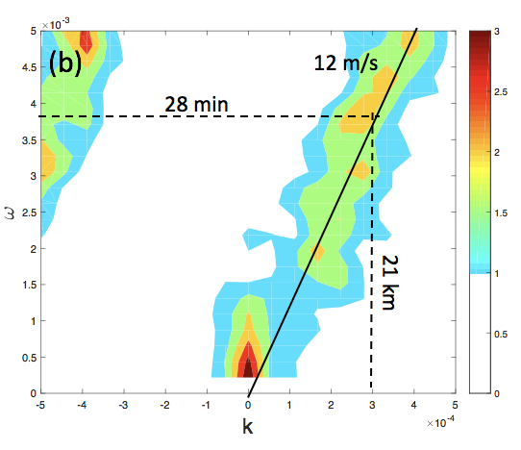
4. Results: Wave duct
Sensitivity tests on the depth of stable layer
Control run: D=1.5km
Sensitivity test D=1 km

Slide 17
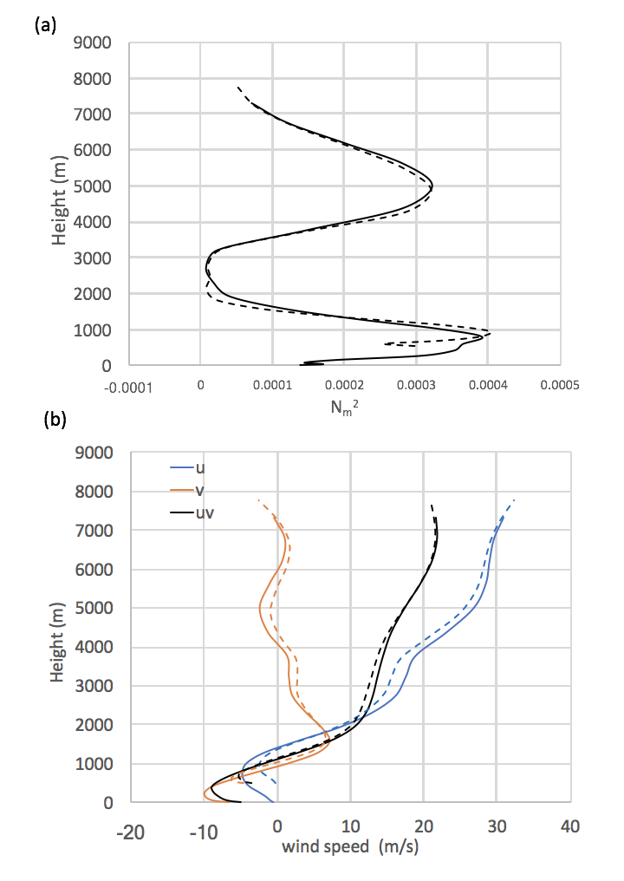
4. Results: Wave duct
Calculation on wave phase speed and wavelength in the sensitivity test
Moist static stability
$$C_{d}=\frac{N_{m}D}{\left(\frac{π}{2}+n\right)}=\frac{0.018 s^{−1}×1000 m}{\frac{3.14}{2}+0}=11.5 m s^{−1}$$
$$C=C_{d}+U=11.5 m s^{−1}−0 m{ s}^{−1}=11.5 m{ s}^{−1}$$
Winds
$λ_{x}=T\left(\frac{N_{m}λ_{z}}{2π}+\overline{U}\right)$=$T\left(\frac{N_{m}×4×D}{2π}+\overline{U}\right)$
=21 km when T=28 min

Slide 18
5. Summary
What’s the role of banded convection in the development of gravity waves?
ANSWER: The convection and gravity waves are coupled via the wave-CISK. Latent heating play a key role in gravity waves
Why did the wavelike pattern of convection last for a long time?
ANSWER: A good wave duct exits that supports to guide and maintain gravity waves at low levels. A low-level stable layer was capped by a reflecting layer with low stability. A critical level exists in the less stable layer surrounding Richardson number less than 1/4.
What factors determine the phase speed and wavelength of the gravity waves?
ANSWER: In the wave duct theory, the depth of stable layer determines the phase speed and vertical wavelength. The lifecycle of convection might further select the wave period and horizontal wavelength

Slide 19
Thank you for your attention

